Slide 1
SQL for E-Commerce & Logistics Analytics
Practical Lab: Brazilian E-Commerce (Olist) Dataset
Tools: XAMPP (MySQL), phpMyAdmin, Google Looker Studio
ROLL NUMBERS
202411044
202410752
202410381
202411043
202411258

Slide 2
Why is SQL critical for logistics optimization
helps companies quickly find and use information from large logistics databases
It makes it easy to track shipments, deliveries, and inventory
Managers can use data to make better and faster decisions
SQL helps create reports and predict future performance
It reduces delays, saves money, and improves overall efficiency

Slide 3
2: How does late delivery affect customer satisfaction
Reduces customer trust in the company
Increases complaints and negative reviews
Causes loss of repeat customers
Damages brand reputation
Leads to higher compensation and refund costs

Slide 4
Which KPI would you improve first as a manager?
On-Time Delivery Rate has the biggest overall impact:
Customer satisfaction
  Late deliveries directly hurt customer trust and experience.
Brand reputation
  Being reliable matters more than being fast but inconsistent.
It influences the other KPIs
  Improving on-time delivery usually:
    Reduces Late Deliveries Count
    Helps stabilize Average Delivery Time

Slide 5
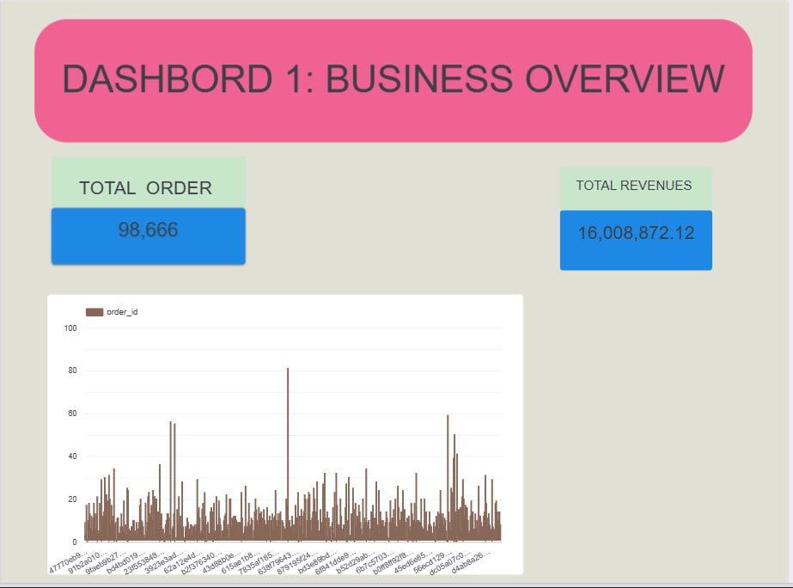
business overview

Slide 6
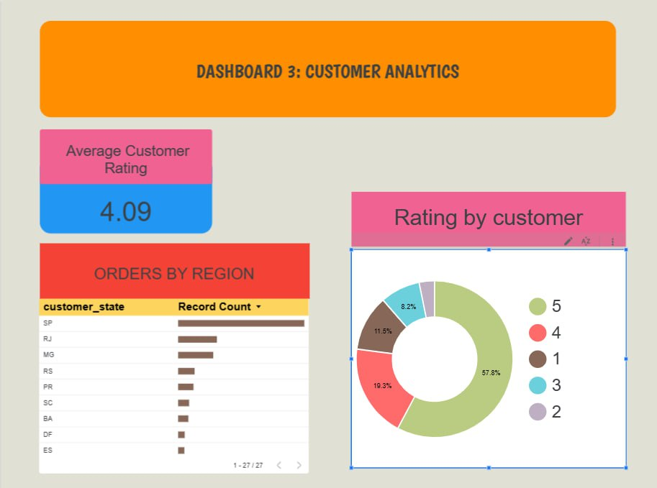
Customer analytics

Slide 7
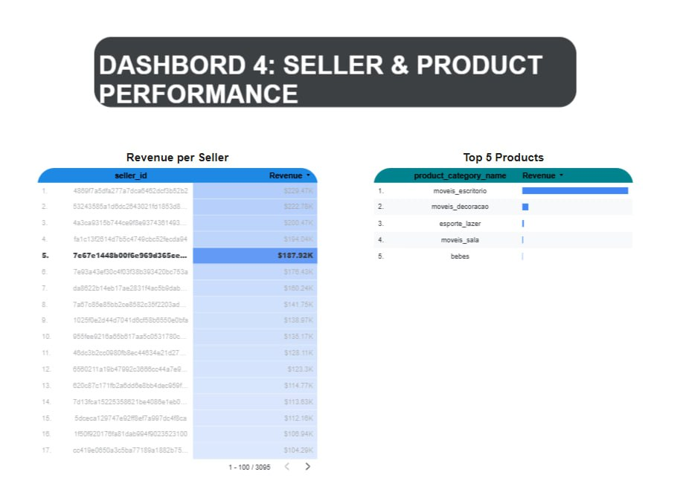
Seller Product performance

Slide 8
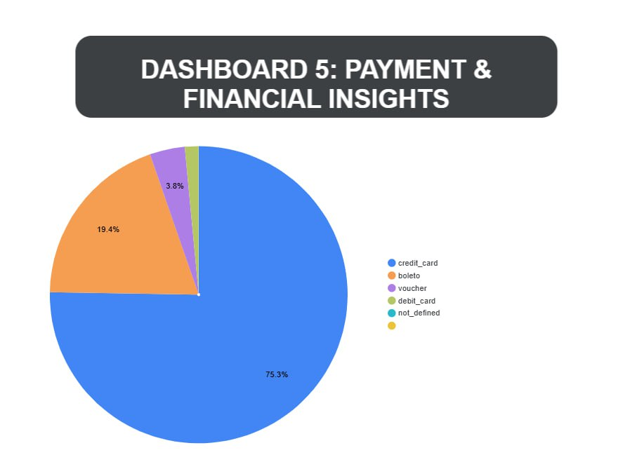
Payment & Financial insigths

Slide 9
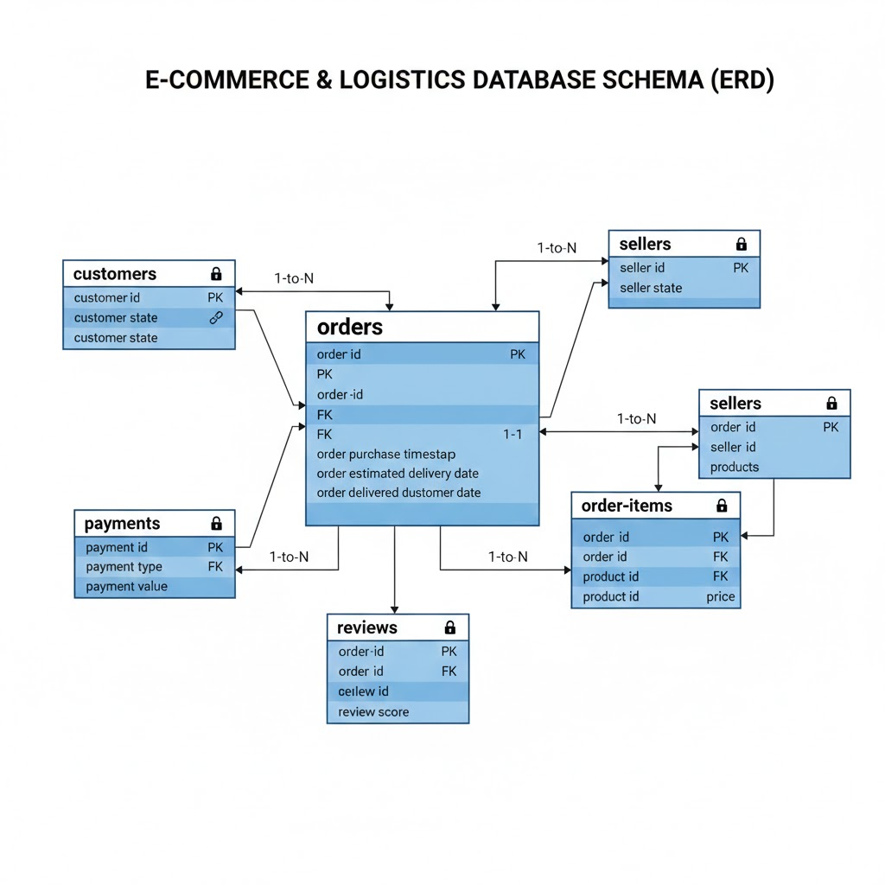
Part 6 - System Integration

